Slide 1
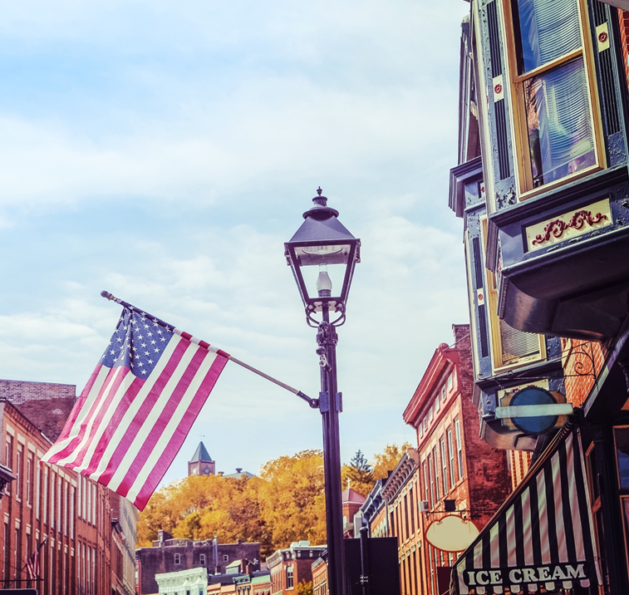

USDA Rural Development
Nebraska Grocery Industry Summit
August 24, 2023

Slide 2
Business & Industry Guarantee Loan (B&I)
Rural Development provides a guarantee for your lender.
Up to $10 million – 80% Guarantee for Lender
3% Guarantee Fee at Loan Closing (1% fee in some cases)
.55% Renewal Fee on declining balance on 12/31 each year
New Business
Business Expansion
Transfer of Ownership

Slide 3
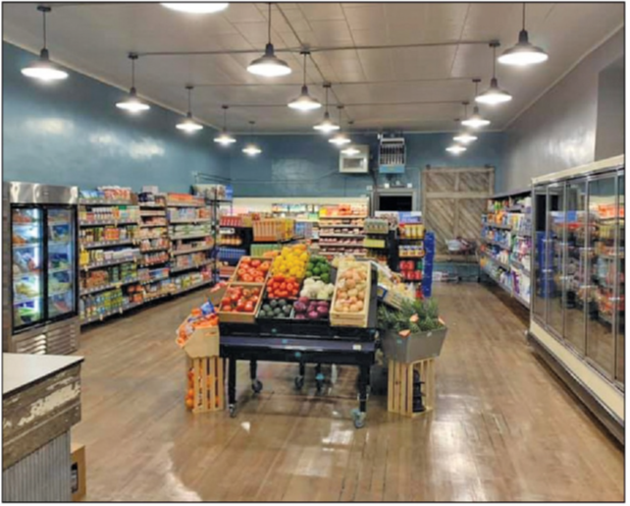
Rural Energy for America Program (REAP)
Grant – 25% (Farm Bill) or 50% (Inflation Reduction Act)
Guaranteed Loan – 50% (Farm Bill) or 25% (Inflation
Reduction Act)
Energy Efficiency Improvements
  Examples: HVAC, Coolers, Compressors, Insulation, Re-Claim Units
  Requires Audit (partner with Utilities)
  Must show energy usage in the past three years
  Bids
Renewable Energy
  Examples Solar Panels, Wind, Geothermal
  Work with vendor for an Assessment

Slide 4
What can a community do when their grocery store is closing?
Here are a few examples . . . .

Slide 5
Example 1
RURAL BUSINESS DEVELOPMENT GRANT
Not-for-profit applied and received funding to purchase vacant building for an incubator.
RURAL COOOPERATIVE DEVELOPMENT GRANT
Nebraska Cooperative Development Center (NCDC) applied for an RCDG to help form and establish cooperatives in Nebraska.
Community worked with NCDC to form a “Cooperative Grocery Store” in rural community.
RURAL ENERGY FOR AMERICA PROGRAM
New “Cooperative Grocery Store” applies for Rural Energy for American Program grant (REAP) to replace coolers, HVAC and lighting upgrade.

Slide 6
Example 2
RURAL BUSINESS DEVELOPMENT GRANT
Community Economic Development Group applied and received funding to establish a Revolving Loan Fund to help small businesses in their community. Bank, County, and Individuals provided matching funds to help the grant score higher.
COMMUNITY REVOLVING LOAN FUND
Community Economic Development Group provided GAP financing to transfer the ownership of 3 businesses in a community of less than 400 people. One of those businesses is a privately owned grocery store.
RURAL ENERGY FOR AMERICA PROGRAM
Grocery store applied for and received grant to upgrade coolers.

Slide 7
Example 3
RURAL ECONOMIC DEVELOPMENT LOAN AND GRANT
Rural Utility working with County applied for the Rural Economic Development Grant (REDG) (up to $300,000) to install an elevator in the Court House. Grant was to the Utility, and they leveraged funds for the 20% match.
UTILITY LOAN TO COUNTY
County pays the loan back to the Utility over 10 years at 0% interest. Funds accumulate in the Revolving Loan Fund
UTILITY REVOLVING LOAN FUND
Loan funds are available to provide loans to for-profit and not-for-profit businesses.
Follows Revolving Loan fund plan and provides loans to businesses for new business, equipment, transfer of ownership, business expansion, etc.

Slide 8

End Slide
USDA is an equal opportunity provider, employer, and lender.

